Slide 1

Digital Portfolio
STUDENT NAME: S.S.AISHWARYA LAKSHMI
REGISTER NO : 222404428
NMID: 4F12ADCBDE6163581D14C2A6868012C8
DEPARTMENT: BSC COMPUTER SCIENCE
COLLEGE: AGURCHAND MANMULL JAIN COLLEGE
UNIVERSITY: MADRAS UNIVERSITY

Slide 2

PROJECT TITLE
MY PORTFOLIO – STUDENT DASHBOARD

Slide 3


AGENDA
Problem Statement
Project Overview
End Users
Tools and Technologies
Portfolio design and Layout
Features and Functionality
Results and Screenshots
Conclusion
Github Link
3/21/2024 Annual Review

Slide 4
PROBLEM STATEMENT
To design a centralized platform for students to organize and showcase their academic achievements.
To provide a simple navigation system
To ensure a professional and user-friendly interface that enhances presentation

Slide 5

PROJECT OVERVIEW
The Student Dashboard is a web-based platform designed to organize and present a student’s key academic and personal information in a structured and user-friendly manner.
The system integrates four main sections:
HOME
CERTIFICATES
RESUME
CONTACT

Slide 6

WHO ARE THE END USERS?
STUDENTS(Primary users)
MENTORS
RECRUITERS

Slide 7

TOOLS AND TECHNIQUES
HTML5 – for structuring web pages.
CSS3 – for styling , layout and navigation design.
Text Editor – for coding.
Content Organization – separate pages for content.
CSS Styling & Effects – background color , highlights etc.

Slide 8
PORTFOLIO DESIGN AND LAYOUT
VISUAL STUDIO CODE
GITHUB
WEBSITES
8

Slide 9
FEATURES AND FUNCTIONALITY
USER-FRIENDLY NAVIGATION
RESPONSIVE DESIGN
SCALABILITY
COMPATIBILITY

Slide 10
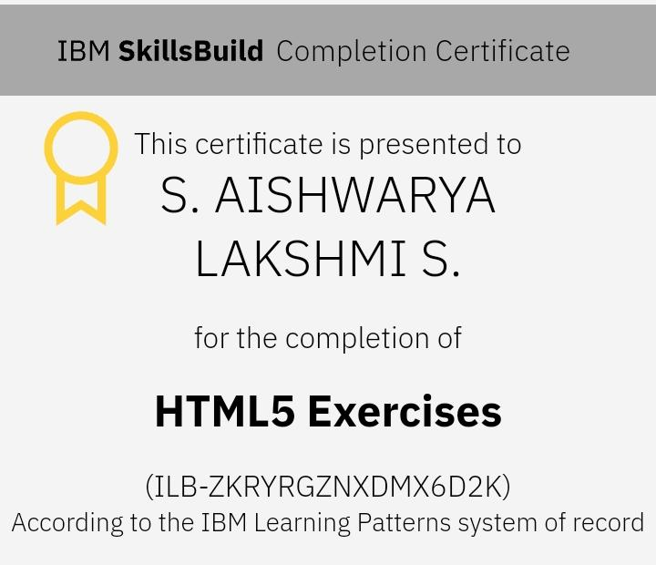
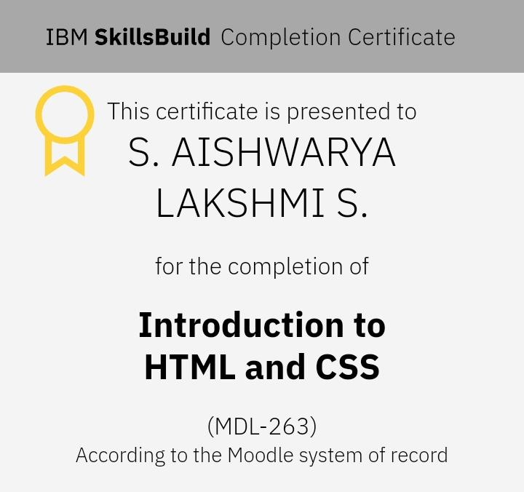
RESULTS AND SCREENSHOTS
10

Slide 11
CONCLUSION
THE END
11

